Slide 1
How to Buy Sell Used Car
Ziad Elassal

Slide 2

Agenda
Description of data
Range of prices based on body type
Is the power of car enough
Mileage and price
Best selling cities
Price with the Year Model
Car Assembly
Car Transmission
Open Markets
City of registration
Price and age

Slide 3

Introduction
This dataset contains data about more than 75,000 used vehicles for sale in Pakistan. This dataset can be used to compare vehicle prices and other features with other vehicles , addition and removal of some features from vehicles will affect the price of vehicle.

Slide 4
Description of data

Slide 5
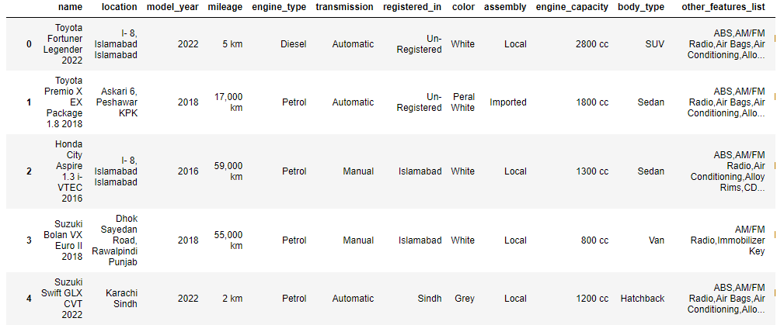
Data Head

Slide 6



Nulls

Slide 7
Range of prices based on body type

Slide 8
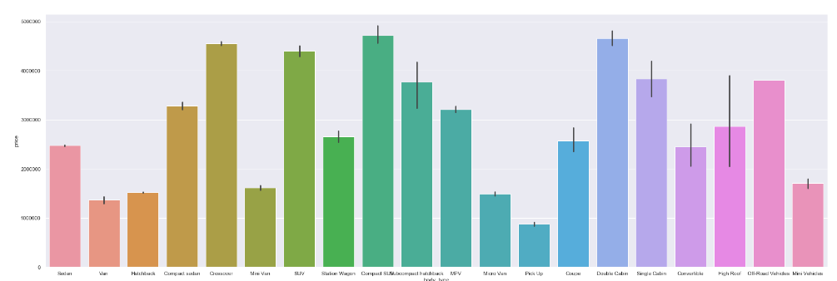
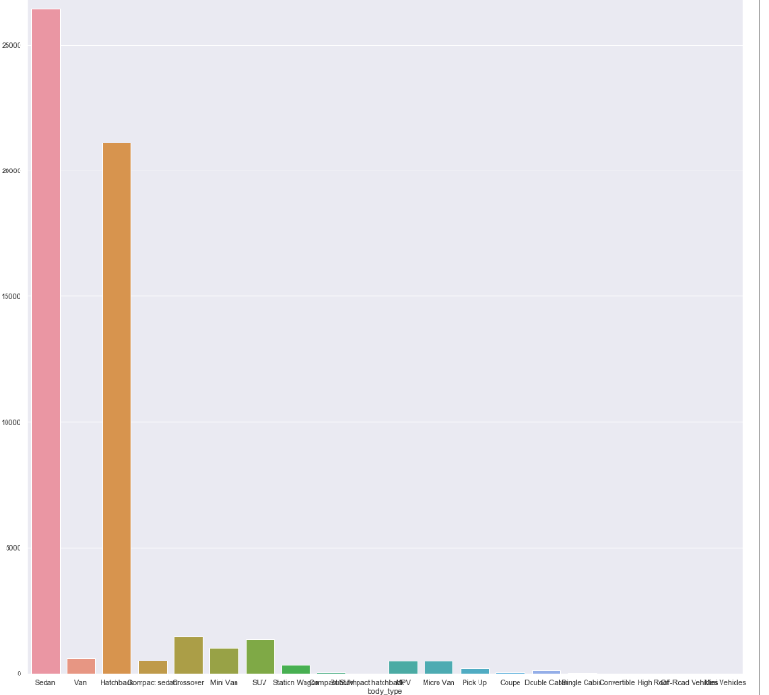
prices based on body type
This gives some intuition about the proper range of price for each body type but it also affects with other features

Slide 9
Is the power of car enough

Slide 10
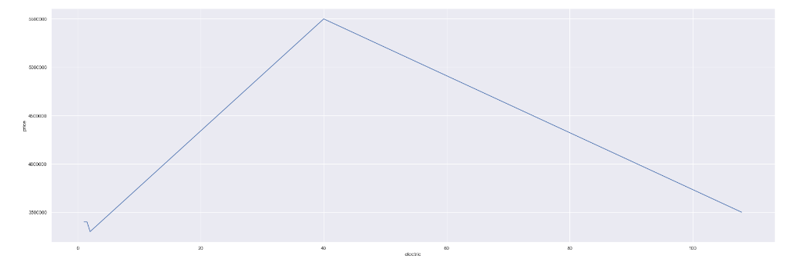
Power of electric cars
For electric cars the kWh does not represent the range of prices of the car as it might be affected by the year and the body type and other luxuries present in the car

Slide 11
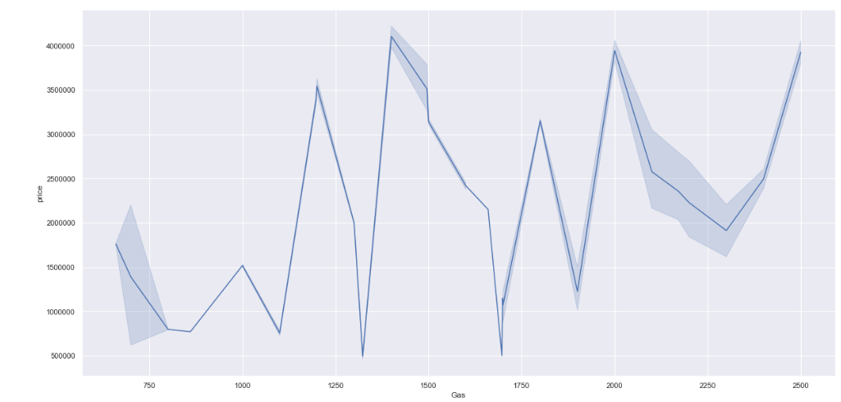
Power of Gas cars
For Gas cars the CC does not represent the range of prices of the car as it might be affected by the year and the body type and other luxuries present in the car

Slide 12
Mileage and price

Slide 13
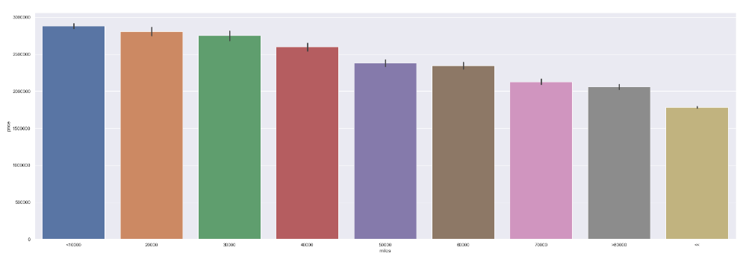
Mileage
The miles that car has been through affects directly the rice so it’s better to consider it while buying used car

Slide 14
Best selling cities

Slide 15
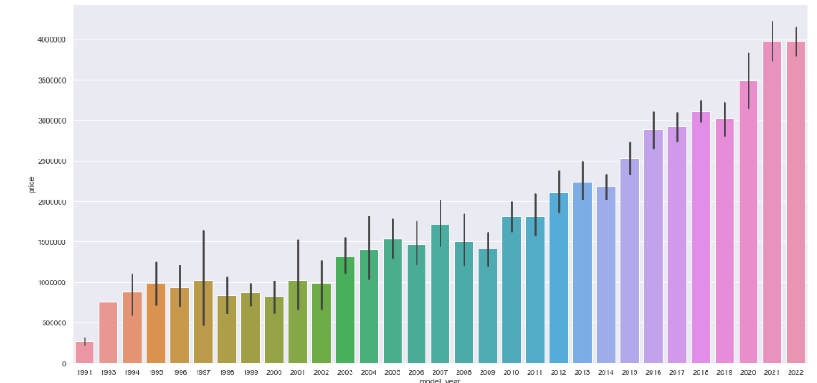
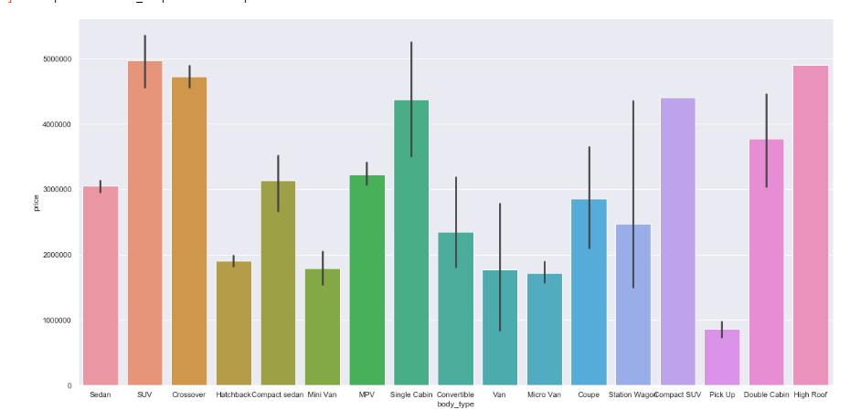
Best selling cities in pakistan
The city that has most car in Pakistan is Lahore Punjab so this an open market that you can sell the car quickly with proper price based on it’s body type and year the year model of a car

Slide 16
Price with the Year Model

Slide 17
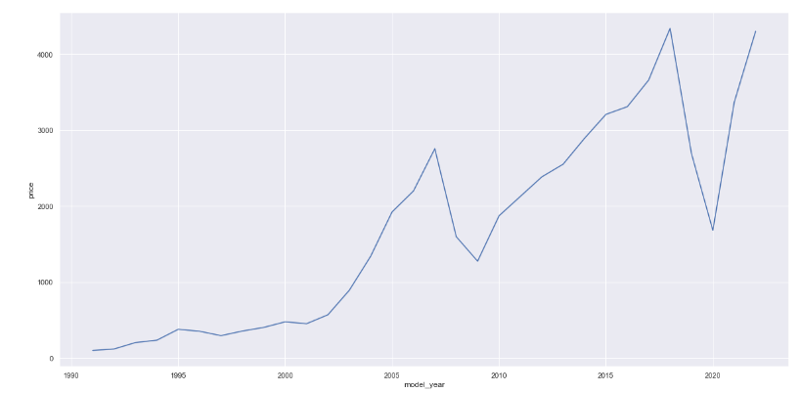
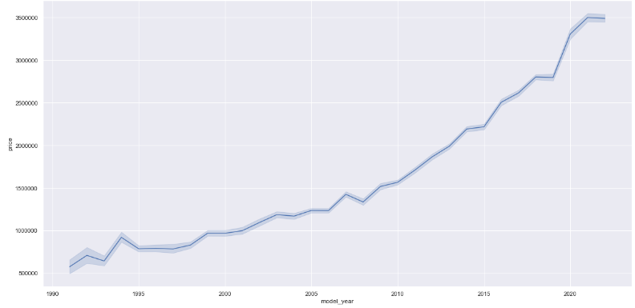
Year Model
The year model does affect the car price mostly the newer car has higher price but there might be some odds but it rarely as the car might was used for rent so its state is not that good .
We might notice that the number of cars in 2008 to 2010 and 2019 to 2021 is less than usual this because of the global crisis that faces the world at this time great depression and Covid-19

Slide 18
Car Assembly

Slide 19
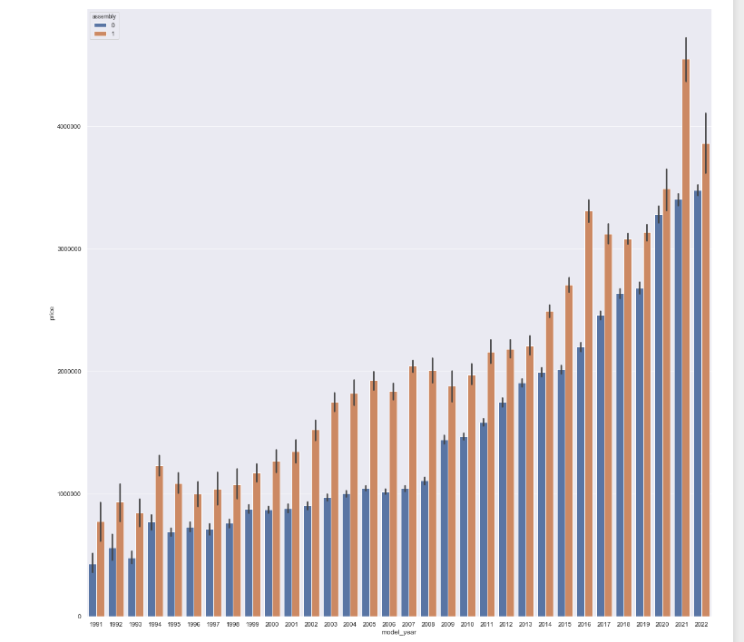
Car assembly
It represent a critical feature that distinguish prices over years as the car that is collected outside the country is more expensive that the local collected one

Slide 20
Car transmission

Slide 21
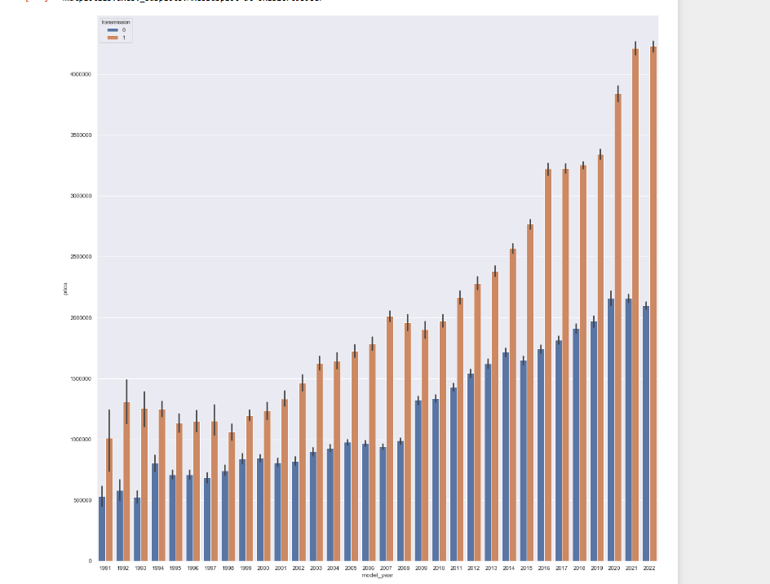
Car Transmission
It represent a critical feature that distinguish prices over years as the car that is collected outside the country is more expensive that the local collected one

Slide 22
City of regitration

Slide 23
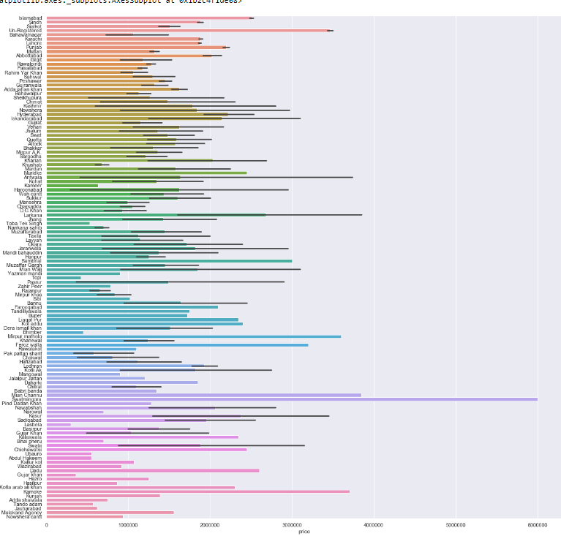
City of registration
The city of registration is not a very critical feature that affect the price as it has so much variety

Slide 24
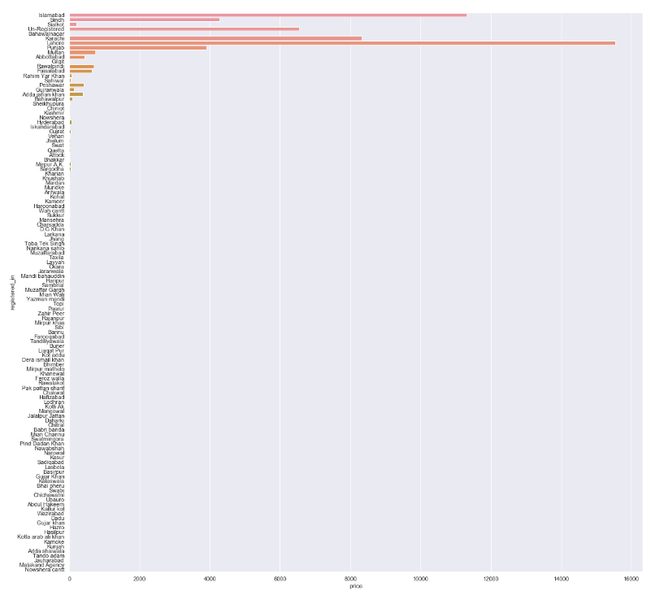
City of registration
The number of cars in Pakistan is concentrated in some city this back :
-The availability of government services
-The population of these cities

Slide 25
Price And age

Slide 26
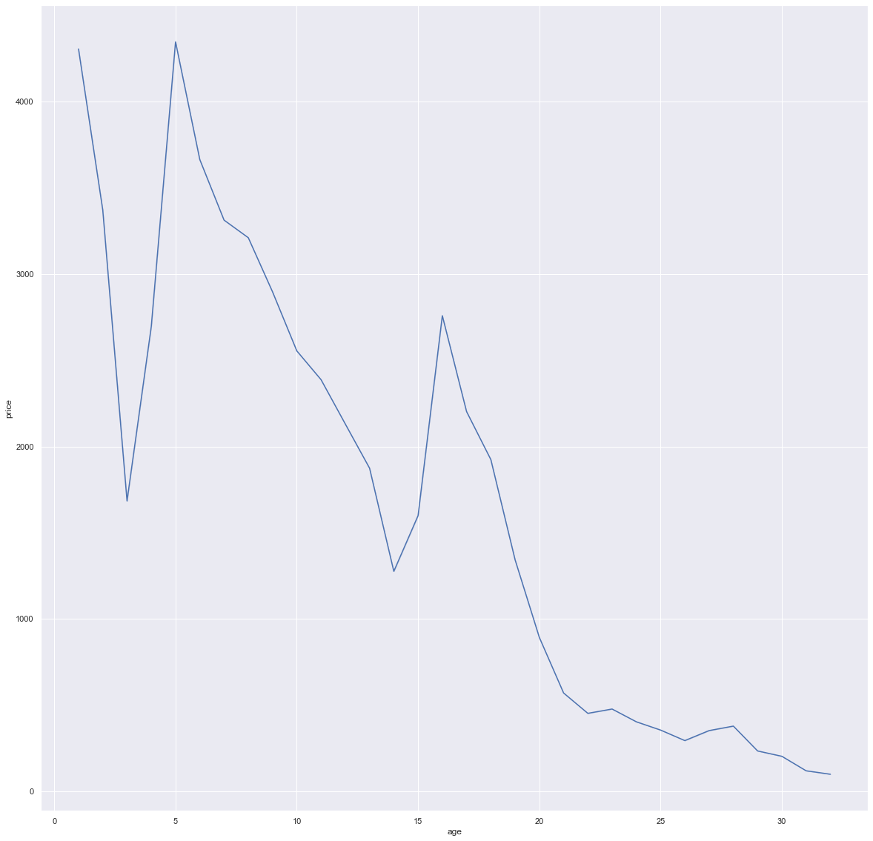
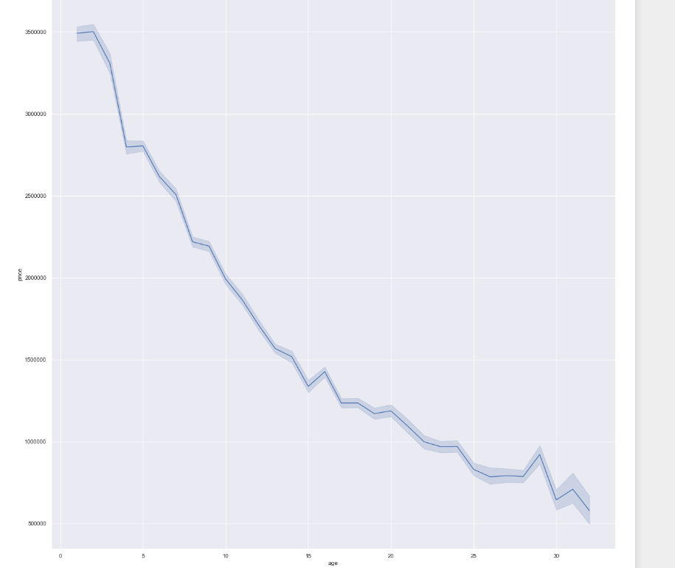
Car age
As the gets older its price gets lower

Slide 27
Open Markets

Slide 28
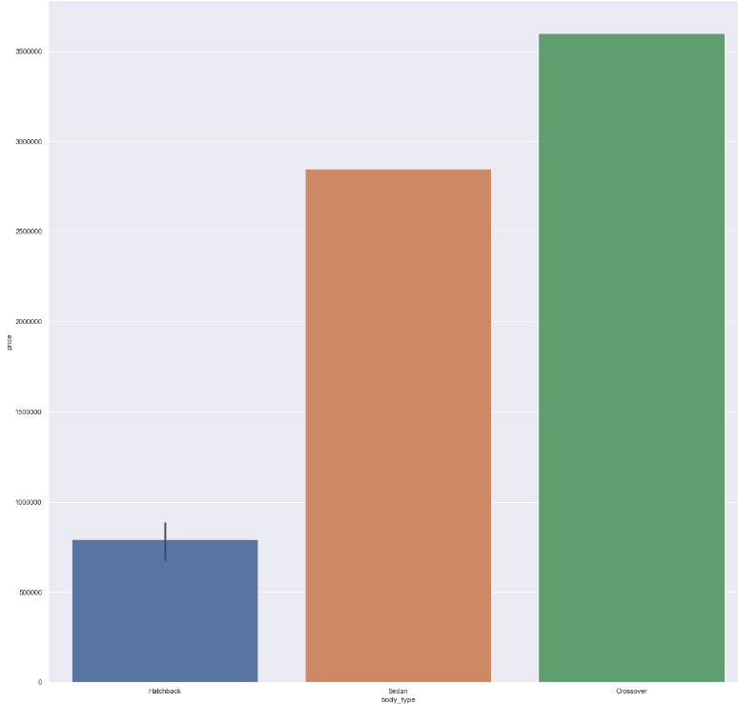
Open Markets
Some cities has lack of body types that is sold in its markets, so this an opportunity sell new body types and newer cars .
This charts represent six cities

Slide 29
Open Markets
As the cars is concentrated in 4 to 5 cities so we can consider other cites as an open opportunities new markets we cans use this chance to sell more in proper prices

Slide 30
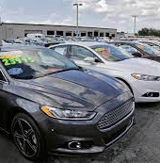

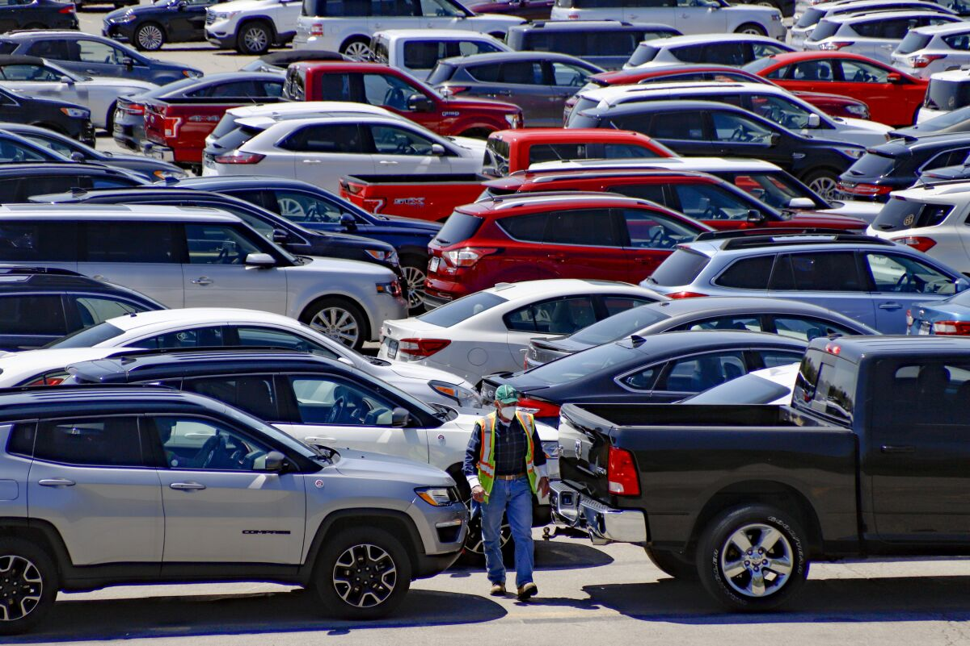
Summary
If you put the year model , body type , transmission and assembly .
Putting in consideration the city you celling your car at and the city of registration of the car this might be a proper indication of the price you will get either you are celling or buying .

Slide 31




Thank you
Best selling cities
Ziad Elassal
Email address ziad.seng@gmail.com

